Slide 1
HCL Orchestration Capabilities
Broadcom IT Process Automation (ITPAM Orchestrator)

Slide 2
What is automation
What do we automate -
How do we automate – code
Why do we automation -

Slide 3
Automation
Automation – preparing solution of tasks which are repetitively done by service desk. Example call center for reset password.
What is a Flow/Process – Something which is done with a plan. Manual – SOP are made to tell service desk people what to do
SOP – Standard Operating procedure – manually things being done by technical spoc
Codes are developed to resolve issues
Scripting based automation – Powershell, Python, VB etc
Automation tools – ITPAM, MS SCORCH, HP OO , truesight AO, Ansible, SNOW orch.
System Tools – AD
Ticketing tools – Remedy , SNOW(Service Now)
Third Party Tools – Netapp, Cisco
DB Management – MSSQL, mysql, Oracle
Monitoring Tools- Nimsoft, SCOM,
IAAC –devOps tools- Jenkins , jira, GIT
Other – Patching(SCCM ), system admin etc.

Slide 4

IT Operations process
Service desk
Ticket creation/Resolution
Technical resolution
End User
Service desk/IVR
ITSM tools
Automation tools/Scripts
End User

Slide 5
Technical resolution
Login on server
Find the issue
Perform steps to Resolve the issue
Validate if issue is fixed
Close ticket

Slide 6
Resolution through automation
Tool will read the issue details from ITSM tool ( ticketing tool)
Runbook trigger
Script – resolve issue
Script – Validate
Runbook Resolve
Script – Powershell, VB etc
Runbook – ITPAM, HP OO , MS SCO

Slide 7
Key objectives in Automation Management
Automation result leading to minimum disruptions, Meeting business expectation while ensuring compliance (regularity, security, Operational)
Risk
Customized Automation based on business requirement & objectiveness.
Customization
Automation timelines to be based on process complexity & maturity
Timelines
Establish shared responsibility between Client & HCL team to ensure transparent, and effective Implementation of automation
Governance
Operational
Efficiency
Right resources, business compliances & effective communication to ensure higher operational efficiencies
Establish overall benefit out of automation and quantify them into cost and other goals within budget.
Cost

Slide 8
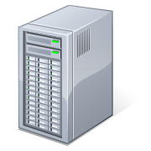

Process Automation & Process
Incident Management
Change Management
Problem Management
Repetitive tasks
Easy tasks with
higher time
consuming process
Prioritization of
tasks based on the
data analysis or
as per Client
requirement
Operation tasks
which has higher
volume as Per
arrival pattern
Complex tasks
with less time
consuming process
Automation (Software or server provisioning, scripts and change execution
Decision on Possibilities of automation
Detailed Repository of all config. Tasks
Configuration Management
Unix
Windows
Compliance Management & Reporting
Analysis
Compliance manager(s)
Service Stakeholder(s)

Slide 9
Process Automation & Process - Examples
Repetitive task :
Monthly/weekly patch update
Server Health check
Change AD password
Easy task with higher time consuming
Disk Clean up
Routing of tickets to respective support team
Operation task has higher volume as per arrival pattern:
High CPU
High memory
Service Start stop
Complex task with less time-consuming process:
Vm memory upgrade
Virtual machine Process upgrade
VM Snapshot/backup

Slide 10
Revision
Introduction to automation
Types of tools we need for automation
Project assignation
SOP – Standard operating procedure - manual step by step doc.
Feasibility Analysis
Solution design
Development in dev env
Testing
UAT
Delivery
Sign off

Slide 11
Initiation & Planning
Automation Assessment
Design & Development
Tool Launch
Automation Sign off and closure
HCL Automation Methodology
Define
Measure
Analyze
Improve
Control
Assign Project Manager
Create Project Team
Identification of Clients/OMC for automation
Expectation setting with Client/OMCs on automation
Communication Plan
Data collection
Map ‘As-is’ Process
Activity Analysis
Volume Analysis
Current Process Performance
High level process Optimization & automation opportunity
Automation team Identification
Detailed Project Plan/Business case
Feasibility & Risk assessment
Fit/Gap Analysis
Architecture assessment and review
High level Tool Design & Deploy
Reconfirm all design elements
Tool Testing (Unit, Integration)
Runbook development of identified use case
Tool Readiness
Production Readiness assessment (Comprehensive Testing)
‘Pilot’ Run
Performance & QA monitoring of tool (UAT & Review)
Final Validation of Tool
Knowledge Transfer & Documentation
Review Post Production performance
Take corrective/ Preventive measures if necessary
Client Sign-off
Project Closure
Status Review
Status Review
Status Review
Status Review
Notes:
11

Slide 12
What is Orchestration ?
Orchestration is an IT process automation platform that automates tasks across multiple functional areas, systems, and geographic locations.
Helps meet strategic IT goals through improving service delivery
Replaces manual, resource-intensive, and error-prone activities
Accelerating routine tasks, such as provisioning and decommissioning physical and virtual assets and IT services
It enables end-to-end automation of key IT processes within the data center
Notes:
The slide introduces Opalis to the System Center Family and also introduces the terms ITPA and RBA which are used interchangeably here.
ITPA meets strategic IT goals by improving service delivery, replacing manual resource-intensive activities. ITPA typically crosses multiple IP silos and disciplines. The more complex a process is, in this respect, the larger the value ITPA can impart on it.

Slide 13
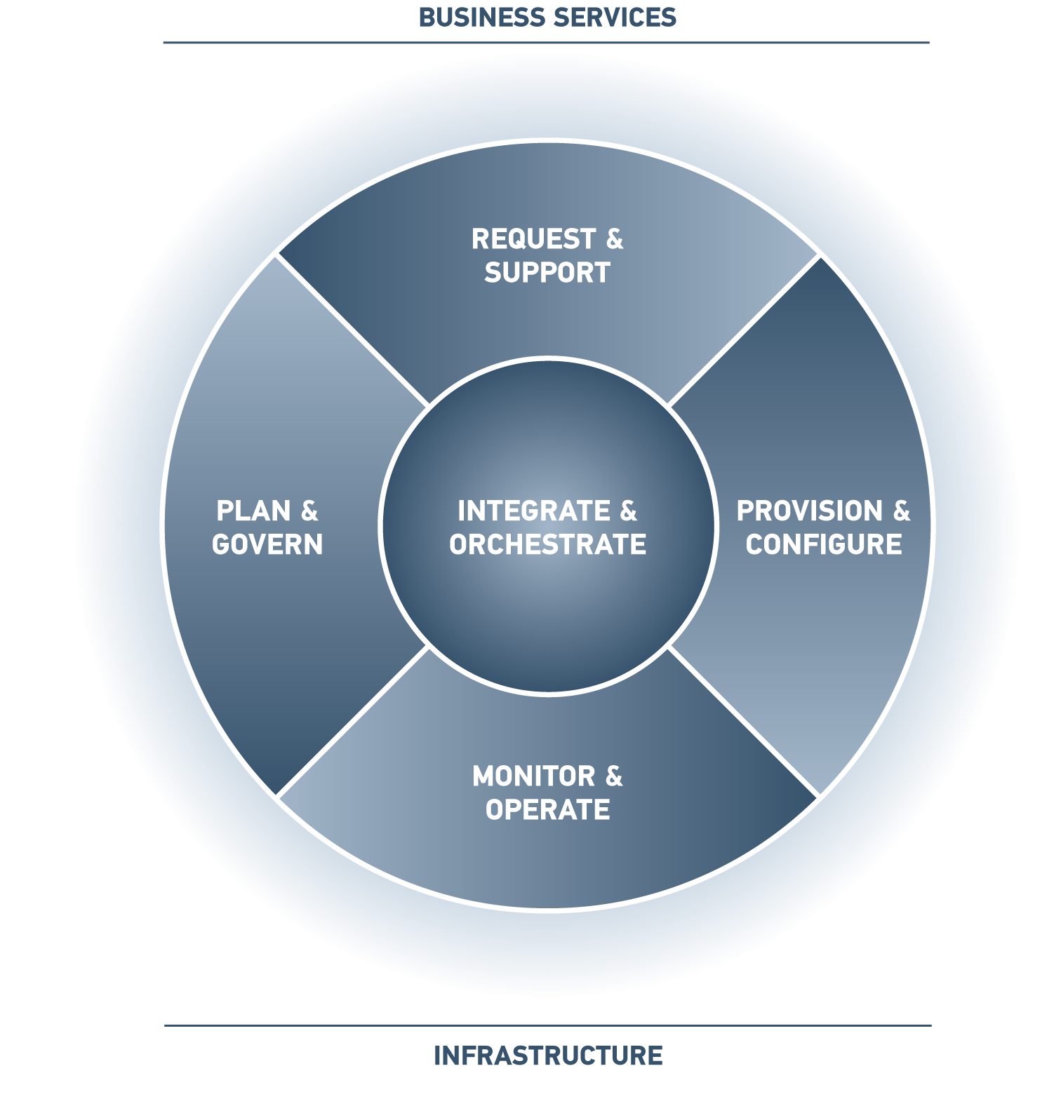
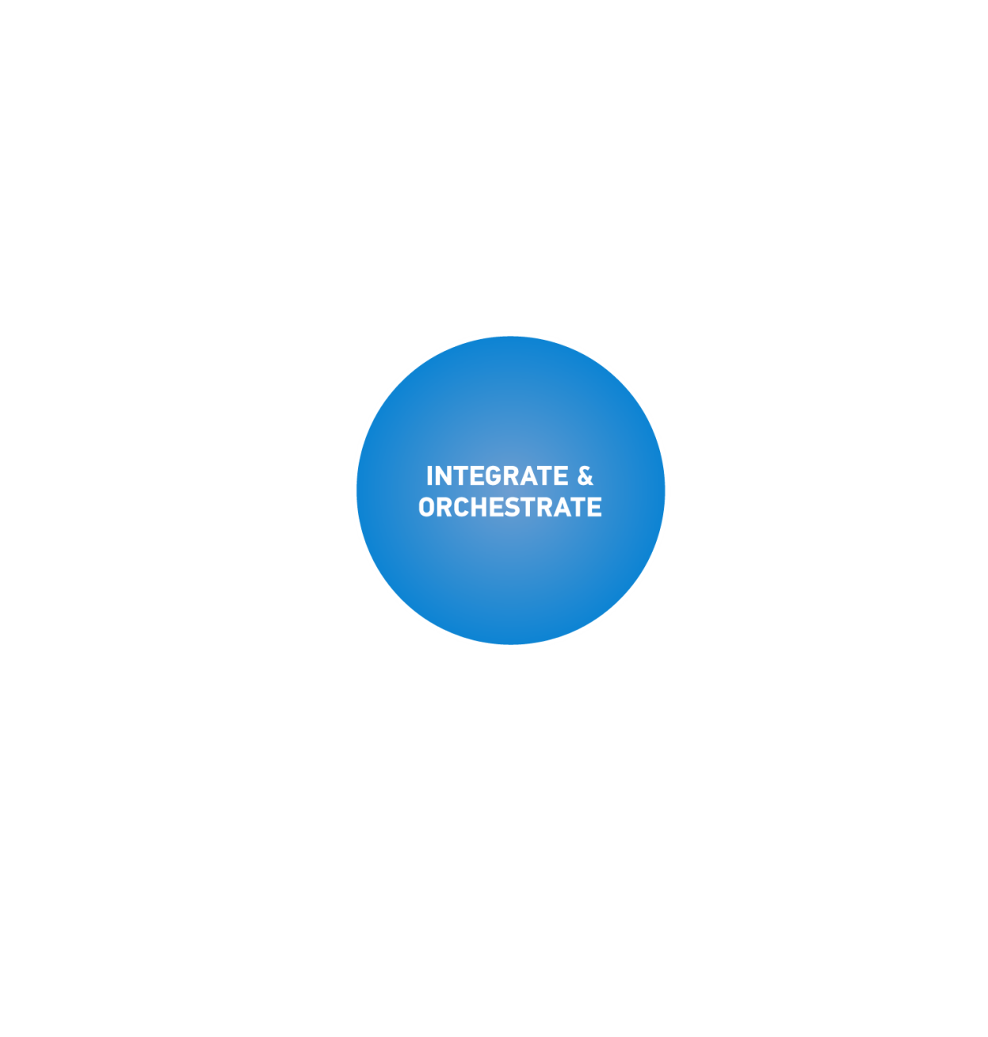
Orchestration Provides
Data Center Automation
Cloud Computing
IT Cost Transparency
IT Decision Support Automation
IT Governance, Risk, and Compliance
IT Service Management
Proactive Operations
ITIL-based business process design and development using the graphical Development Studio

Slide 14
Runbook Automation
Runbooks are pre-built workflows ready for deployment which are based on ITIL best practices and are customer proven.
Runbook automation orchestrate the automation of IT operations management processes, unifying the communication of the underlying, supporting, IT management tools in support of the process.
Some important runbooks involve full stack provisioning and de-provisioning, virtualization management, closed-loop compliance, accelerate paper run books, Routine Operator Actions, Service Recovery Actions, On-boarding New Users and Customers, Triage and Remediation.

Slide 15
Broadcom IT Process Automation Manager
- Designed to speed the delivery of IT services while helping to remove manual errors.
Lets you automate IT processes across multiple organizations and systems, reduce the service delivery time, and enforce standards and compliance policies across departments.
Helps you automate IT processes to:
Reduce operational expenses
Increase staff productivity
Speed IT service delivery
Improve service quality
Enforce compliance polices

Slide 16
Components
Domain(Master/Main) orchestrator (Runbook Server)- Mandatory
Orchestrator – not mandatory
Broadcom EEM – embedded entitlement manager – mandatory – User management
SQL Server
ITPAM Agent/proxy agent
Features
ITPAM is a thin client
Pre-defiled operations
Agent based
LDAP authentication
User access control

Slide 17
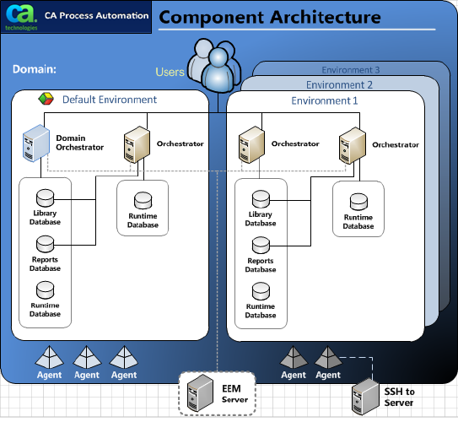
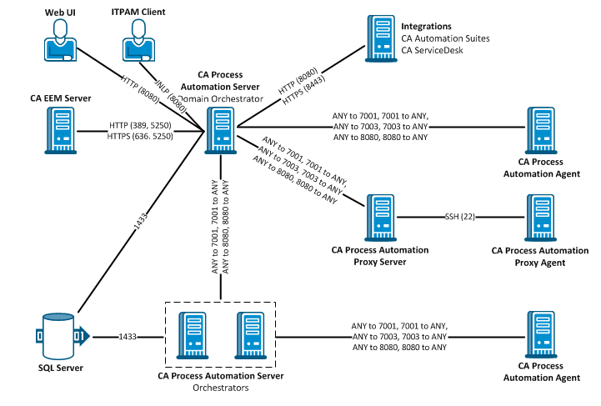
ITPAM Component Typical Architecture

Slide 18
Types of databases
DBs are created by default at time of installation
3 types
Library – Hold all your workflows/Variables/Codes/conditions
Runtime – Execution logs –(fail/Success) – time /execution. Error details/ what was the output
Reporting - Domain orchestrator logs, EEM activities, Any actity which is done in any component. This will also hold runtime details

Slide 19
ITPAM Building Blocks for Custom Automation
Solutions are content for PAM and potentially other products that are used to integrate and orchestrate 2 or more CA products for a target market need.
Integrated
Solutions
Power Packs are content for PAM and potentially other products that are used to integrate and orchestrate 1 or 2 products to solve common use cases
Power Packs for Workload Automation AE
Power Pack for VMware View VDI
Power Pack for Event – Incident (SpecIM to Remedy Gateway)
Power Packs
Combination of processes and connectors
Function as tutorials and building blocks for larger content types
QuickStarts
Collection of Operators
Integrations to key IT and business applications
Connectors
Operators are functions, methods or activities that fulfill a step in a process
Custom Operators are base operators that are wrapped and provided with unique input fields for easier reuse by other content designers.
Operators

Slide 20
RBA & ITPAM Benefits
Runbook automation Benefits:
Operational efficiencies in repetitive tasks
Operational efficiencies in complex and time consuming tasks
Utilization of L2/L3 resources in more complex and more productivity tasks
Overall reduction in manual efforts
Reduction in MTTr and MTTR (Mean time to respond and resolve)
Automate repetitive tasks
Automate complex and time consuming tasks
Increase resource efficiency
Improve SLAs – Service level agreement.
Well defined processes
Better Compliance
Eliminate manual errors
Improve speed of execution

Slide 21
RBA & ITPAM Benefits…contd
ITPAM Benefits:
Capable of creating Service Request forms (SRF), which provide another level of end user interaction with underlying automation workflows.
Capable of creating Interactive Request From (IRF), an alternate way to provide inputs during workflow execution.
Can work across active directory domain boundaries, therefor easily suited for heterogeneous domain architectures.
Highly scalable and highly available architecture
Localized and environment based library repository for shared and isolated environments respectively.
Based on worldwide standard javascript scripting
Good cross platform support.
Provide an easy interface for creation of custom connectors, for integrations where OOB connectors are not available.
Availability of integrated solutions, power packs and many connectors for custom automation with CA.
Better exception handling and lane handling during workflow development.
Better Runtime Security and permission settings (FIPS compliant integration with EEM , LDAP, and AD support)
Role-based access control (allows tool support people (post project delivery) to monitor or troubleshoot based on only necessary roles privileges)

Slide 22
HCL Automation Repository
Below are the categories in which HCL has already done automation and ready to deploy with minimum customization as per customer requirements:
Active Directory
Amazon Web Services
Bladelogic
Database SQL, Oracle and MySQL
Event Logs Management
Exchange Server
FIle Handling Windows & Linux
FTP Windwows & LINUX
IBM EndPoint Manager
ITSM BMC Remedy
ITSM Service Now
Windows OS
Linux OS

Slide 23

HCL RBA Customers

Slide 24
Process Automation Demo Use Cases
Auto-Remediation for High Disk Utilization Alerts– Automate the resolution of high disk space incident tickets raised from an event management or monitoring system (Nimsoft/Moogsoft) using customer defined rules and filters.
Patch Management –Handle patch management of infrastructure servers in an automated fashion by leveraging integration with server automation tool (IBM Endpoint Management) and request management portals (Service Now)
Virtualization Compute:- Handle request for upgrading RAM and other VM operations like host info, Power ops and handle network adapters from virtualization platform (SCVMM) and automatic resolution for the requests at ITSM portal

Slide 25
Revision
ITPAM components(Domain orchestrator, EEM , Agent, proxy agent,SQL server)
Architecture (port)
Installation
Databases
Java scripting
LDAP and AD
Users

Slide 26
Itpam
Datasets – variable
Log files
Types of processes

Slide 27
ITPAM Quick Start Guide - [PDF Document] (vdocument.in)
CA IT PAM Quick Start Guide (broadcom.com)
CA IT Process Automation Manager End User Interaction Tutorial (broadcom.com)
ITPAM Best Practices - sc (broadcom.com)
IT PAM Architecture and Scalability Guide (broadcom.com)

Slide 29
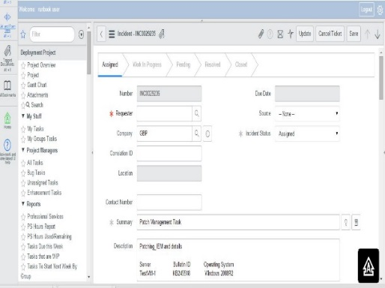
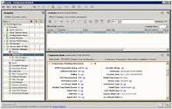
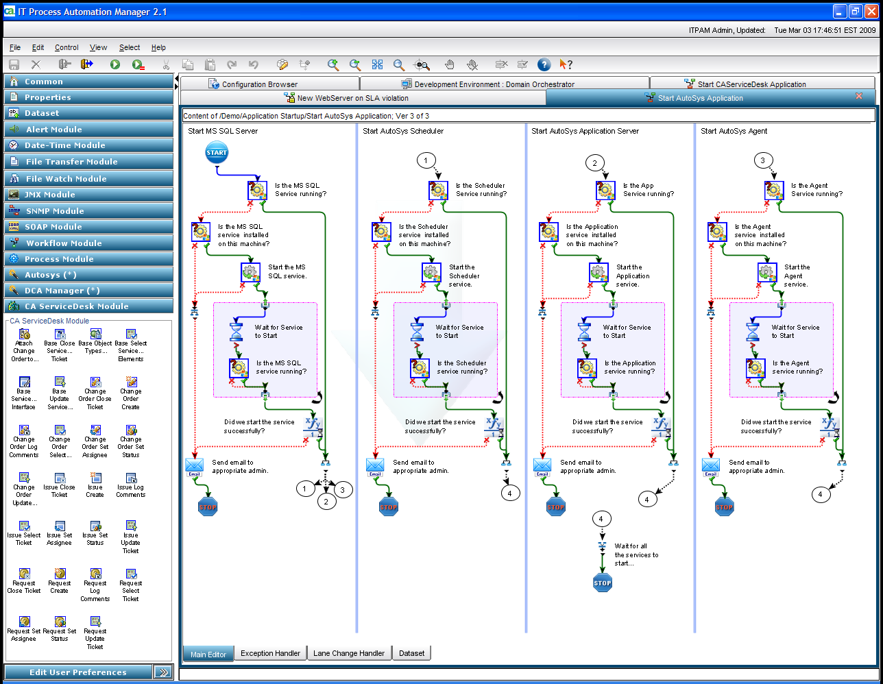
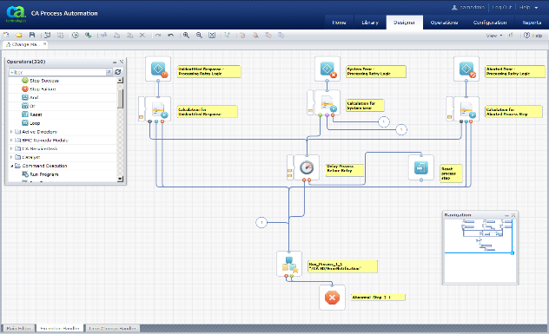
Orchestration & Automation (Disk utilization)
Nimsoft alert is trapped at Moogsoft for High Disk Usage
Incident opened in ServiceNow
Orchestrator solution is triggered
ITPAM solution is triggered and picks up relevant information from Service
ITPAM solution performs threshold comparison and cleans up disk
Updates the Incident ticket and routes to concerned team for further action
ITPAM workflow does threshold comparison
to verify alert and performs disk clean up/

Slide 30
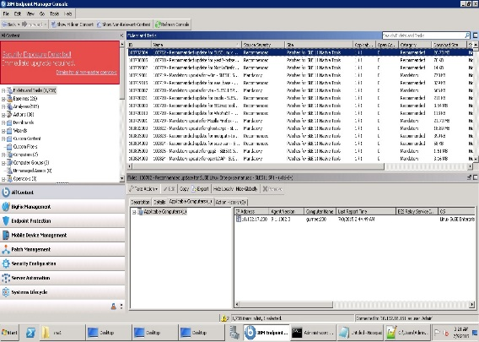
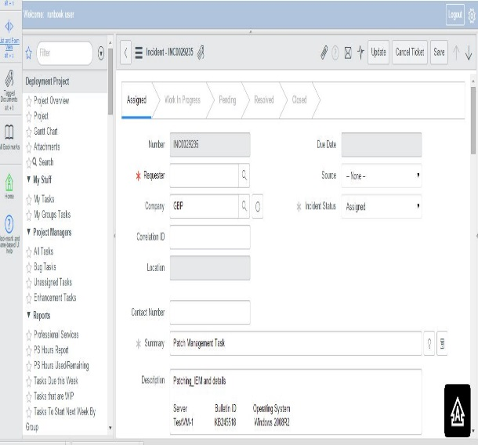
Orchestration & Automation (Patch Management)
Patch Details is published for the Month
DC Team Shares Patch Details for activity and Service Request is raised in ServiceNow
Actions scheduled at IEM
Orchestrator solution triggers for Patch Management in IEM

Slide 31
Orchestration & Automation (Patch Management)
Step by Step Process Automation
Update logs
Generated
consolidated Reports
Combine
Results
Start
Receives patch
details
Patch Server
Verify Patches
Success
Fail
Notifies
concerned
teams
Open
Intelligent
Incident
Update
SR
Ticket
ServiceNow
Incident
Adapter
Service Request
Adaptor
End
Server
Automation
ServiceNow
Incident
Service Now
SR
Server
Patch
Management
Incident
Management
Service Request
Management
Data Center

Slide 32
Orchestration & Automation (Disk Utilization)
Disk Utilization
Performs
corrective
actions
Collects health
State
Combine
Results
Fetch Details from Incident
Compute and
Compare
with
Threshold
Success
Fail
Notifies
concerned
team
Formulates
the
computed data
Update
Incident
Ticket
CA Adaptor
ServiceNow
WebServices
Start
Triggers an Incident in ServiceNow
End
CA Nimsoft
MoogSoft
ServiceNow
Co-related Alert Passed from Nimsoft to MoogSoft
Incident
Management
Data Center

Slide 33
Orchestration & Automation (Virtualization Compute-RAM Upgrade)
End User raises a request in ITSM portal for RAM upgrade
Request opened in ServiceNow
ITPAM solution is triggered and picks up relevant information from ServiceNow
ITPAM solution performs action for RAM upgrade on the VM
Resolve the ticket or routes it to concerned team for further action
in case of exception
Orchestrator solution is triggered
ITPAM workflow performs configuration check on VM to get Host details

Slide 34
Case Studies

Slide 35
Case Study: Fortune 300 Engine Manufacturer (USA)
Following automation scenarios are implemented using BMC tools like BMC Bladelogic, Atrium Orchestrator & Remedy ITSM
Automated Provisioning
Windows Bare Metal Provisioning (2003, 2008)
Solaris SPARC Bare Metal Provisioning & Zones creation
Post Provisioning tasks : Software Installation, Server Hardening etc.
Application Environment Provisioning
Oracle Database Provisioning (10g & 11g)
Upgrade Oracle from 8, 9 to 10g
Oracle patching for CPU performance
Siebel Provisioning (CRM, UCM)
Automated Patching
Windows 2003, 2008
Solaris SPARC 10
Compliance Reporting
SOX Reports
Operational Compliance
Server Configuration Management & Packaged Deployment

Slide 36
RBA Case Study – Manual Vs Automation CPU/Memory Utilization
S.No | Task | Average Duration (Manual) | Average Duration (Using RBA)
Step1 | Pick the details from Remedy ticket and start working | 30 sec | 5 sec
Step2 | Login to Server to check the exact CPU/Memory Utilization | 1 min | 5 sec
Step 3 | Run the command to check current CPU/Memory Utilization | 1 min | 10 sec
Step 4 | If CPU/Memory Utilization is less than the threshold value. Go to remedy and change the Status of ticket to resolve and update the workinfo | 2 min | 5 sec
Step5 | If CPU/Memory Utilization is greater move ahead to find the processes which are consuming more CPU/Memory ( for top process commands need to run ) | 2 min | 10 sec
Step 6 | Checking which process is Application process/System Process | 30 sec | 5 sec
Step 7 | Finding the top Application Process with its usage value | 30 sec | 5 sec
Step 8 | Login to MASSDB and fetch the Application Name against the server for which ticket is logged | 1.5 min | 20 sec
Step 9 | If top Application process exist in MASSDB fetch the Application Name and Application Owner Email ID | 4 min | 30 sec
Step 10 | Send Mail to Application Owner with details of the ticket and process details with usage | 3 min | 20 sec
Step 11 | If Owner not respond to the ticket send reminder mail with escalation to CI Site manager (On going process Until Owner respond) | 3 min | 10 sec
 |  | 19 minutes | 2 minutes

Slide 37
Best practices
Plug and Play
Camel casing – firstName.
Use of ReturnCode and ReturnMessage
0 – Success, 2-Access denied , 3- unknown exception
ReturnMessage – Sentence (human readable)
Naming the operator
Taking backups.

